Slide 1
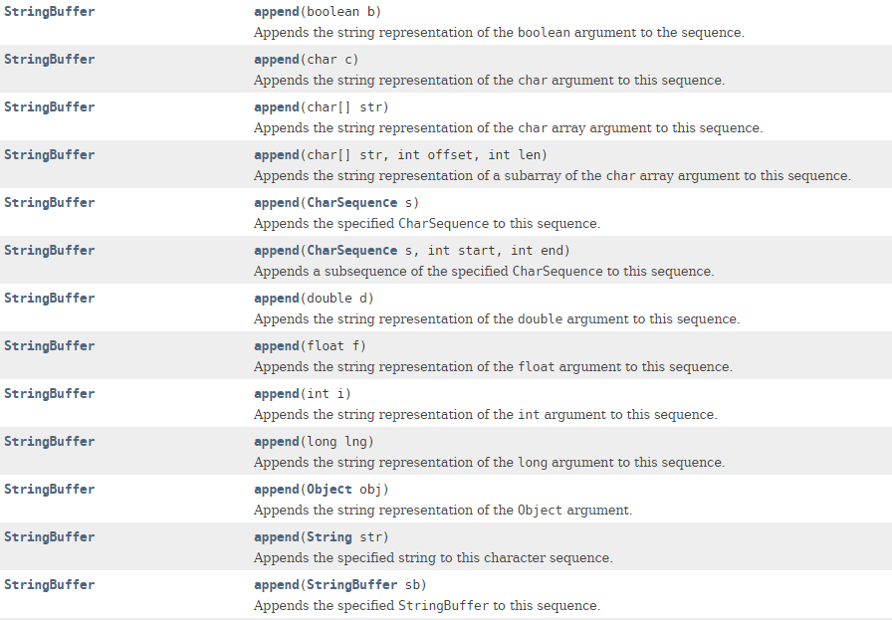
StringBuffer – append method

